Slide 1

Final Project:
World Cup Prediction
Group Name: France/Portugal/Argentina 2022
Group Member: Haoyi Cheng, Jianyu Chen, Sen Luo
University of Pennsylvania
CIS 5200 Machine Learning

Slide 2
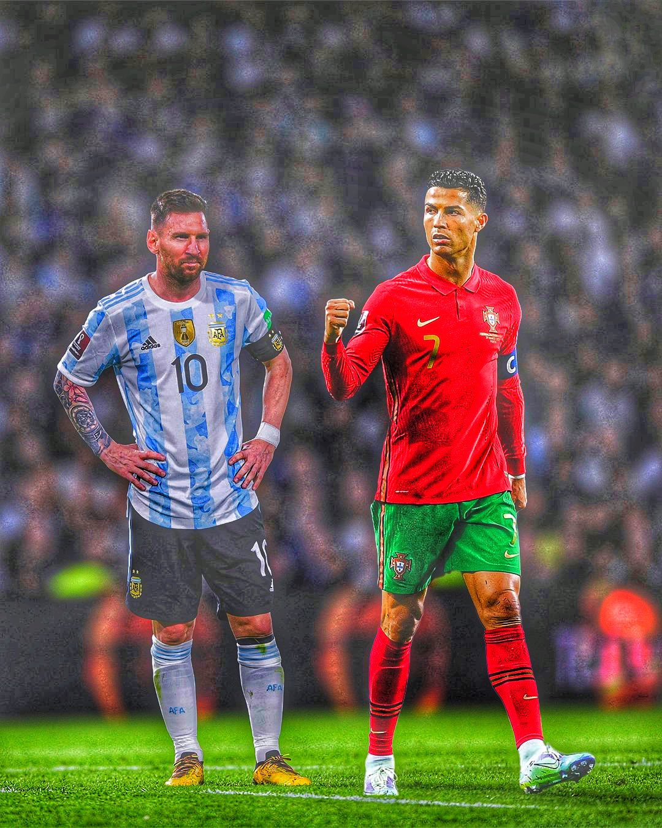
Background:
2022 Qatar FIFA
World Cup!!!

Slide 3
Dataset:
FIFA game database:
https://www.fifaindex.com/
Past 30 years football game data:
https://www.kaggle.com/datasets/brenda89/fifa-world-cup-2022
FIFA world ranking:
https://www.fifa.com/fifa-world-ranking/men

Slide 4
Data:

Slide 5
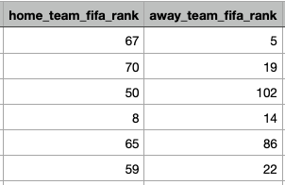
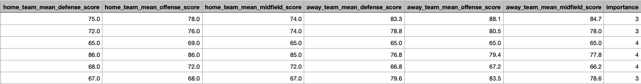
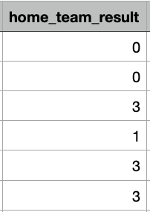
X-train:
Y-train:

Slide 6
Methods
Baseline: Decision Tree
Package: sklearn.tree.DecisionTreeClassifier
Logistic Regression
Package: sklearn.linear_model.LogisticRegression
Random Forest
Package: sklearn.ensemble.RandomForestClassifier
Gradient Tree Boosting
Package: sklearn.ensemble.GradientBoostingClassifier
Support Vector Machine
Package: sklearn.svm.SVC
Neural Network
Package: sklearn.neural_network.MLPClassifier

Slide 7
Evaluation
Accuracy score
model.score(X_test, y_test)
K-fold cross validation (k=5)
cross_validate('test_score')
Hyperparameter Tuning
Before using the trained models to predict the upcoming world cup, we should first find the optimal hyperparameter combinations of each model. So next we will use grid search to tune the hyperparameters. For example, we should find the best kernel and regularization parameter for SVM.

Slide 8
Pick the best method
Tuned Model | Decision Tree | Logistic Regression | Random Forest | Gradient Tree Boosting | SVM | Neural Network
Accuracy score | 47.36% | 58.81% | 58.50% | 58.81% | 59.18% | 59.37%
K-fold CV score | 46.11% | 58.15% | 58.33% | 58.35% | 58.20% | 58.24%

Slide 9
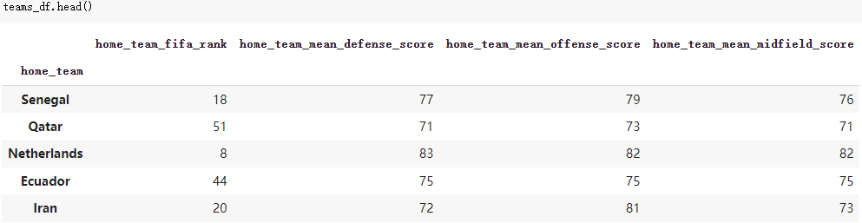
Prediction:
After comparing the accuracy of all methods，we choose Gradient Tree Boosting. We manually create rows for Qatar 2022 participating teams.

Slide 10
Group Stage:
We define margin equals to 0.1 so that we can more easily distinguish between win, draw, and lose. Gradient Boost algorithm can predict the winning probability of the home team.
Away team win: P <= 0.5 - margin
Draw: 0.5 - margin < P < 0.5 + margin
Home team win: P >= 0.5 + margin

Slide 11
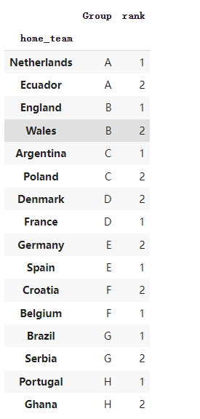
Result:

Slide 12
Round of 16:
After the Group stage, it becomes a knockout round, with only wins and losses.
Away team win: P <= 0.5
Home team win: P > 0.5

Slide 13
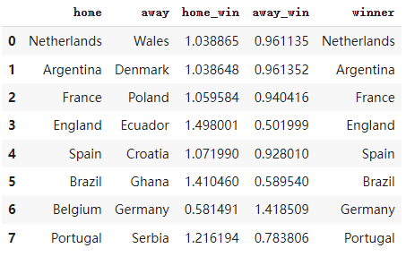
Round of 16 Result:

Slide 14
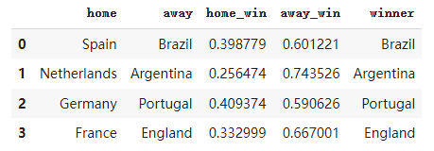


Quarter Finals Result:
Semi Finals Result:
Final Result:

Slide 15
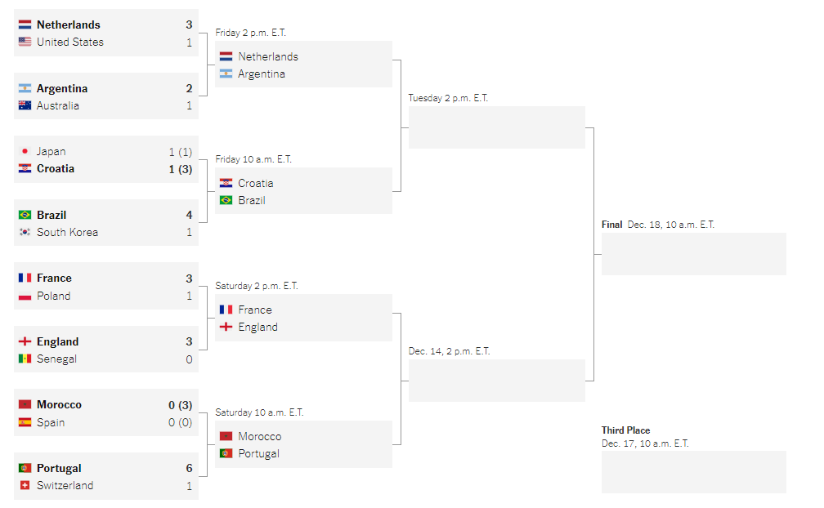
So far, the game has reached the quarterfinals.

Slide 16
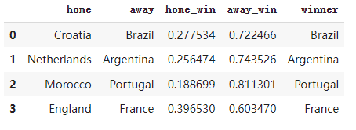
Quarter Finals prediction:
Looking forward to seeing whether our predictions are accurate.

Slide 17
Thanks for watching!

